Slide 1

LMP-03
Deep Learning based Facial Action Control Mobile Game (Android Version)
Supervisor: Dr. Po, LM
Assessor: Mr. Ting, Van C W
Student: Cheng Darren
Notes:
Hello everyone, welcome to my final year project presentation! My project is centered around using deep-learning-based computer vision technology to create a facial action control mobile game in Android, that promotes facial muscle exercise to reduce the aging process of the face. I am Darren, and I am very excited to share my project with you.

Slide 2



Introduction
Goal:
Type of facial movements suitable for mobile game control?
Use facial motion recognition algorithms as controls for the game
Create a new type of mobile game
Objective:
Promote Facial Muscle Exercise to reduce the aging process of the face
Notes:
This project aims to study which types of facial movements are suitable for mobile game control and to use facial motion recognition algorithms as the main controls for the mobile game. We hope to create a new type of mobile game that brings a unique user experience, with the objective of promoting facial muscle exercise to reduce the aging process of the face.

Slide 3




Facial muscle exercise
Promoting
Promoting blood circulation
Toning
Toning Muscles
Reducing
Reducing Wrinkles
Will you do facial exercise regularly?
Notes:
Facial muscle exercises have been found to help reduce the aging process of the face by promoting blood circulation, toning muscles, and reducing wrinkles. However, many people find it challenging to regularly do facial exercises on their own.

Slide 4


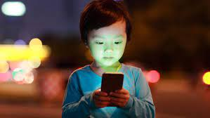
Facial Muscle exercise -> mobile games
User experience
Notes:
With that said, to promote facial exercise, I think it is best to implement it into a game. As the incorporation of facial recognition technology in mobile gaming may significantly enhance user experience, and a game with good user experience provides players with satisfying and immersive experience that keeps them engaged and entertained. I seek to create a new type of mobile game that not only entertains but also contributes to facial muscle exercise and anti-aging efforts.

Slide 5


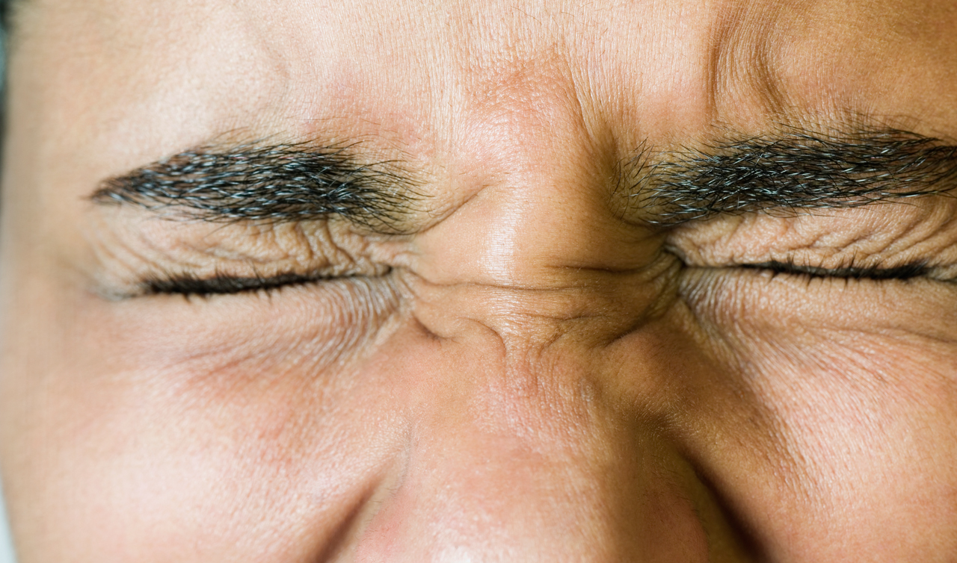



Types of Facial movements suitable for game
Notes:
I have done a little research on facial movements and obtained 4 major movements that are suitable to be used as mobile game controls. These 4 facial action controls correspond to mouth movements, blinking motion, tongue movements and smiling motion.
In my game, I used these two motions, simply because I like to.

Slide 6


Research
Notes:
To prove that the aforementioned motions can really train facial muscles, I would like to share with you some of my research.

Slide 7
Blinking motion
Facial muscles trained:
orbicularis oculi muscle (surrounds the eye). This muscle is responsible for blinking and squinting and plays a big role in nonverbal communication, as it helps to convey emotions such as surprise or concern.
Pros:
Blinking is an essential action for maintaining healthy eyes and vision, as it provides lubrication, protection, and helps to reduce eye strain and fatigue. It also improves vision and stimulates brain activity. Besides, research also discovered that gamers tend to blink less frequently. So blinking motion in game solves this problem.
Cons:
Blinking too repeatedly could cause eye fatigue and strain, which can be very uncomfortable and make it difficult to continue playing the game. Also, some people might not have strong control over their blinking (e.g., if they have dry eyes or a medical condition), which could negatively affect the gameplay.
Notes:
First of all, blinking motion. Blinking motion can train our orbicularis oculi muscles. This muscle is responsible for blinking and squinting and plays a big role in nonverbal communication, as it helps to convey emotions such as surprise or concern. Blinking is an essential action for maintaining healthy eyes and vision, as it provides lubrication, protection, and helps to reduce eye strain and fatigue. It also improves vision and stimulates brain activity. Besides, research also discovered that gamers tend to blink less frequently. So, using blinking motion to play the game solves this problem. However, blinking too repeatedly could cause eye fatigue and strain, which can be very uncomfortable and make it difficult to continue playing the game. Also, some people might not have strong control over their blinking (e.g., if they have dry eyes or a medical condition), which could negatively affect the gameplay. And that’s why I also implemented smiling motion.

Slide 8
Smiling motion
Facial muscles trained:
zygomaticus muscles (raises the corners of the mouth) and orbicularis oculi (causes crow's feet). This muscle is responsible for smiling and is important for facial expression and communication.
Pros:
Smiling releases endorphins, improves your mood, relieves stress, boosts immunity, enhances relationships, and makes you more attractive and approachable. Even if you forcefully or intentionally smile, you can still trigger the same positive benefits associated with a genuine smile.
Cons:
Like blinking, smiling could cause facial fatigue or strain if the player has to do it repeatedly for a prolonged period. Also, some people might find it difficult or uncomfortable to smile for extended periods of time, especially if they have dental braces, sore teeth, or other oral health issues.
Notes:
For smiling motion, zygomaticus muscles that are in the corners of the mouth and orbicularis oculi muscles are trained. The first mentioned muscle is responsible for smiling and is important for facial expression and communication. Smiling releases endorphins, improves your mood, relieves stress, boosts immunity, enhances relationships, and makes you more attractive and approachable. Even if you forcefully or intentionally smile, you can still trigger the same positive benefits associated with a genuine smile. However, like blinking, smiling could cause facial fatigue or strain if the player has to do it repeatedly for a prolonged period. Also, some people might find it difficult or uncomfortable to smile for extended periods of time, especially if they have dental braces, sore teeth, or other oral health issues.

Slide 9

Dagger Master
Notes:
Now, enough with the boring research data. Let me introduce you “Dagger Master”.

Slide 10
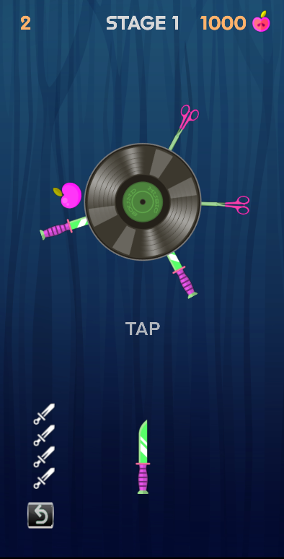
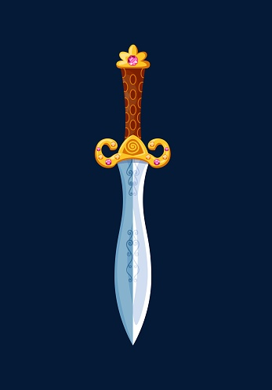
Game Introduction
What game is it
Dagger throwing game
Objective
Challenges players to throw daggers at rotating targets without hitting other daggers that are already on target.
Notes:
Dagger Master is a Dagger throwing game. It challenges players to throw daggers at rotating targets without hitting other daggers that are already on the target.

Slide 11

Why this game?
Originality
Idea came from a game named “Knife Hit”
Why I choose to develop this game
Simple to play
More applicable for facial controls implementation
Notes:
Now you might ask, why this game? The idea of this game came from a game named Knife Hit. I chose to develop this game due to its simplicity. It is easy to play, with only one goal, which makes it more applicable for facial controls implementation.

Slide 12
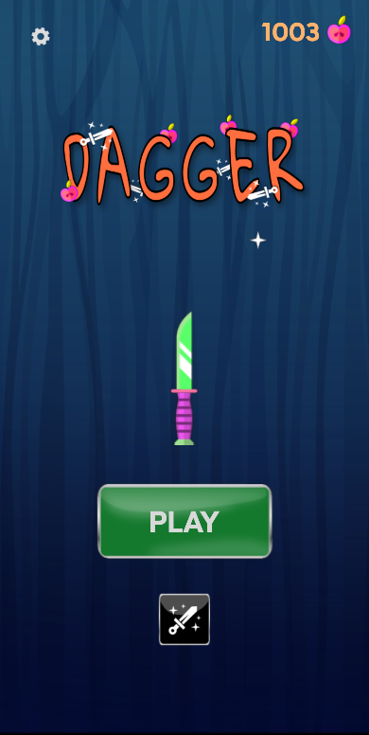
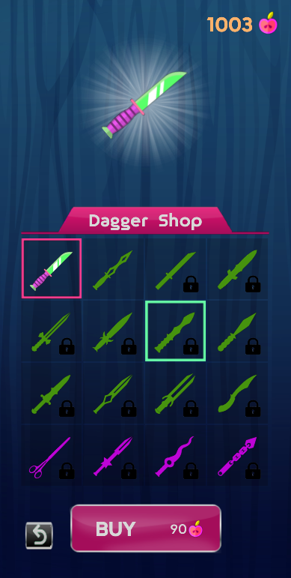
Game DESIGN & Game Logic
Notes:
I have spent a lot of time on the game design and game logic, and I would like to spend a little time demonstrating what my game looks like.

Slide 13
Main Screen
This page can access every functional part of the game.
Fruit: act as Data points/Currency
Notes:
First of all is the main screen, this is the page where users can access every functional part of the game. As you can see, we have a large play button that starts the game and a shop button right underneath it. A large dagger in the middle indicates the selected dagger that the user is using. On the top row, we have an indicator indicating the fruit count which acts as data points or the main currency throughout the game and a settings button that links to the settings screen.

Slide 14
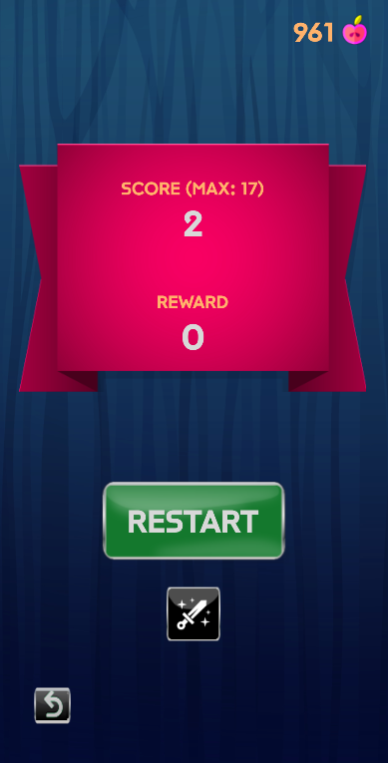
Game Screen
Fully Responsive
Perfection
10+ Animations
Score board implementation
Notes:
Next up is the game screen. The game screen is the trickiest part during development, where I have to make everything responsive and smooth. As it directly determines whether the player will like this game. Everything on this screen reacts perfectly as soon as the player takes any action. I have implemented more than 10 animations to make the game incredibly fun to play. When the player loses, a score board slides down and tells the player all the necessary information. And up till now, you might ask, why isn’t the game played with facial action controls?

Slide 15
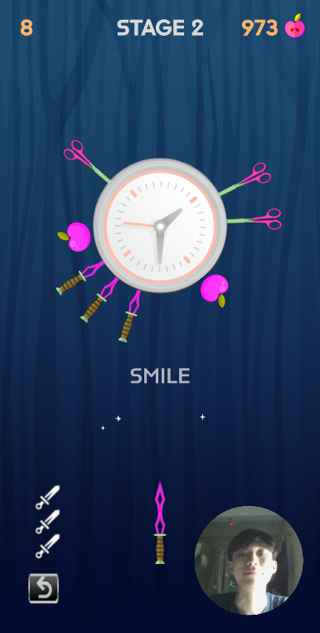
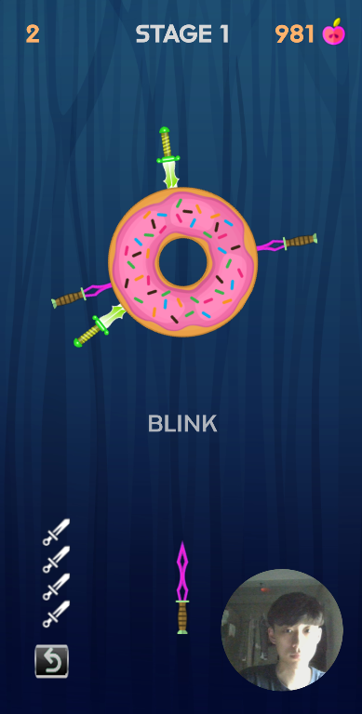
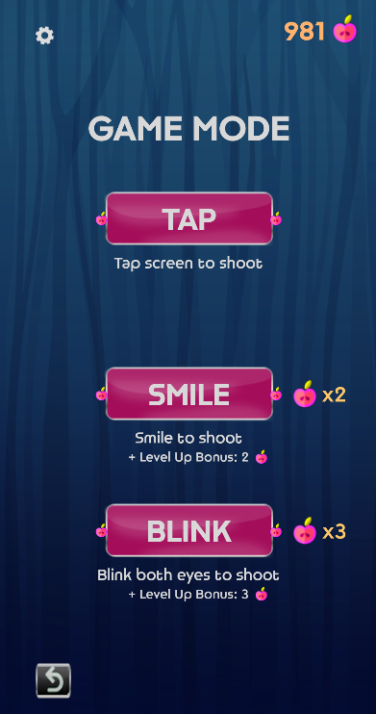
Game Screen (Add in Facial Action controls)
3 different game modes
3 different reward systems
Camera Util that helps the player to have a better control on the game
Notes:
At first, the game is indeed built and controlled by tap motion for ease of development. Afterwards, I succeeded in implementing blinking motions and smiling motions, and I allowed the game to be played in 3 different game modes, each with a different reward system, making the game more appealing and attractive. Players have the option of selecting from different game modes that not only add diversity to their gameplay, but also can mitigate the negative impacts brought on by overtraining facial muscles. From the UI, you can see a camera util set on the right bottom corner. It allows the player to have a better acknowledgement on what the camera is capturing, so as to promote better control over the game.

Slide 16
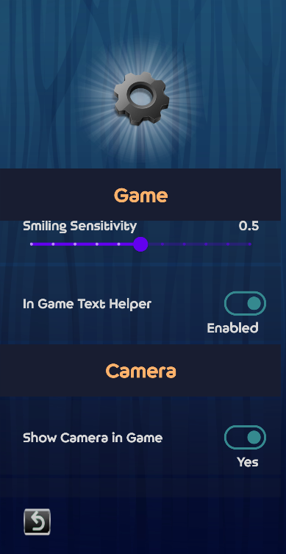
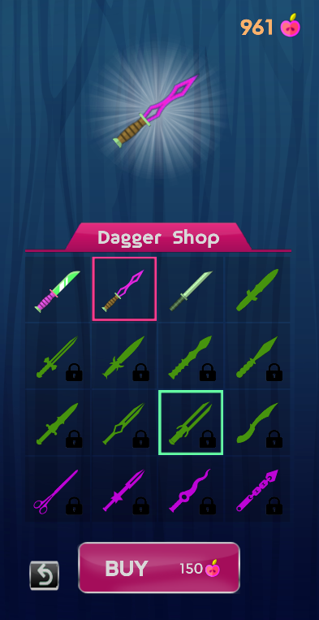
Features
Level system
Difficulty increases as level increases
Random speeds starting from level 3
Currency system
Earn fruits to buy daggers
Shopping system
Total of 16 daggers
Settings system
Facial action sensitivity
Camera settings
Notes:
At this point, you might think this game is as simple as it looks. But I can tell you that the challenge quickly ramps up as the target rotates faster and new obstacles are introduced. A level system monitors the difficulty of the game, where the difficulty increases randomly each time the level increases. Random speeds of spinning target are also introduced starting from level 3. Besides, we have a currency system, where fruits are the only currency accepted in this game for players to buy daggers. And here is where the shopping system kicks in. Last but not least, the settings system is here to provide game and camera settings for players to fine-tune some variables during gameplay.

Slide 17
Technology Used
IDE
Android Studio
Language
Kotlin
Facial Action Control Library
Google ML Kit -> Facial detection
Tools & Dependencies
Coroutines
Navigation Compose
Navigation Animation
Datastore
Camera
Toolkit
Jetpack Compose
Notes:
Now, I am going to talk about the technology used for the game. Android Studio is the IDE used, with Kotlin Jetpack Compose as the overall framework for this game.

Slide 18

Technology Used
1. Capture Image from Camera
2. MLKit processes Image
3. Check if face exists
4. Retrieve Information from face
Facial Action Control Library
Google ML Kit -> Facial detection
Notes:
Google ML Kit’s Facial Detection module is the library that powers all the eye blinking and smiling control. The methodology behind it is actually very simple, where the camera captures images, send it to MLKit to process, then retrieves information from the face detected, in every millisecond.

Slide 19
Technology Used
IDE
Android Studio
Language
Kotlin
Facial Action Control Library
Google ML Kit -> Facial detection
Tools & Dependencies
Coroutines
Navigation Compose
Navigation Animation
Datastore
Camera
Toolkit
Jetpack Compose
Notes:
While facial detection itself is not enough to control the game, here is where we go deeper into the tools and dependencies.

Slide 20
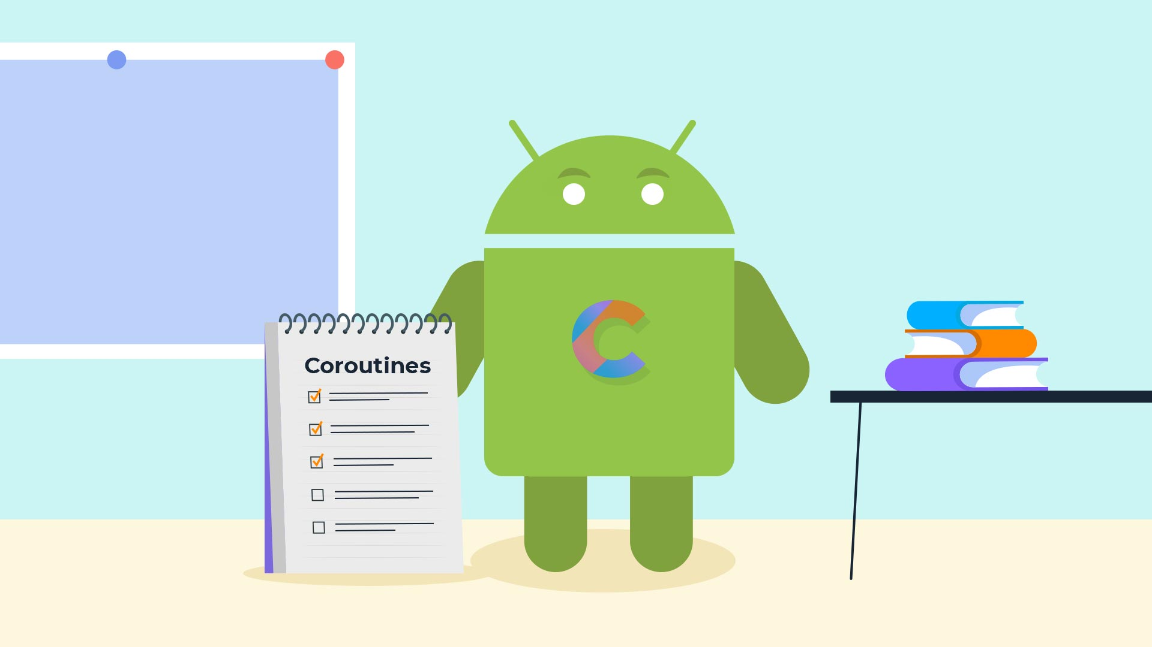






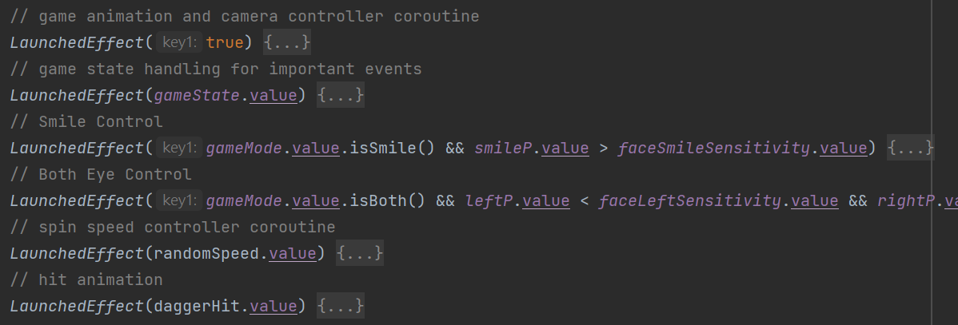
Technology Used
Tools & Dependencies
Coroutines
Navigation Compose
Navigation Animation
Datastore
Camera
Navigation
Datastore
Notes:
Navigation compose and navigation animation library have allowed me to carry out navigations with animation throughout the whole game.
Datastore allows Dagger Master to store game data in local storage, saving user preferences and all game data such as fruit count, number of daggers bought, max score, etc.
While coroutines is the most important, it is basically a sub-process for managing asynchronous tasks and state changes in a reactive and efficient way. This picture only showed coroutines in part of the game screen. But I can tell you, almost all the game logic such as the spinning target, state changes, animations, as well as facial motion control logics, work out because of this powerful technology.

Slide 21

How effective is this game?
Conducted a survey to gather feedback for my game from individuals across various age groups.
16 simple questions
Accessing the games
Responsiveness
Feasibility
Effectiveness
User Ratings on the game
Notes:
After explaining the mechanics of my game, I am interested in measuring its effectiveness in terms of training facial muscles. I would like to assess how well the game improves facial muscle tone and strength and gather feedback and insights from players on the effectiveness of the game for this purpose. I have conducted a survey to gather feedback for my game from individuals across various age groups.
This survey comprises 16 straightforward questions that aim to evaluate the game's responsiveness, feasibility, effectiveness in terms of facial action controls and gameplay, and overall rating. The questions are designed to gather valuable feedback from players and assess their experience playing the game, including how well it improves facial muscle training and toning.

Slide 22
According to current responses
Most players
Not sure if they are interested in this new type of mobile game
are willing to play this game 3-5 times a week
Think that:
the game is easy to understand and operate
facial action control is fairly responsive and precise
facial action control have a positive effect
Agree that this game helped them in terms of facial muscle training
Feel significant changes in terms of facial muscles
Notes:
According to current responses, most players still haven’t had an idea on whether they are interested in this new type of mobile game. They claimed to be willing to play this game 3-5 times a week. Most players think that the game is easy to understand and operate, where the facial action control is fairly responsive and precise. They also think that the facial action control have a positive effect to facial muscles and agree that this game helped them in terms of facial muscle training. Last but not least, most claimed that they feel significant changes in terms of facial muscles.

Slide 23
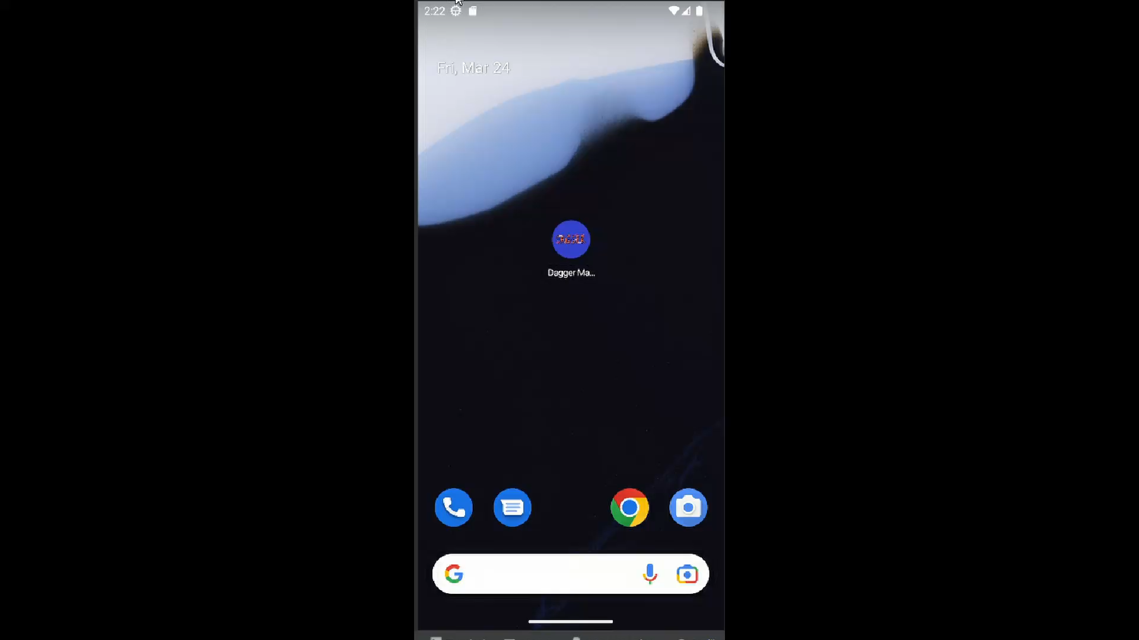
Gameplay
Notes:
Without further ado, I would like to give you a quick demo of Dagger Master.
You will enter the main screen after seeing this loading screen.
Here is where you choose different game modes. By the way, smooth animations, right?
Here comes the score board.
In the shop, pink box indicates selected daggers. Green box indicates current selection. And here, you purchase.
Next up is the settings screen. We have game settings, as well as camera settings.
Now, I’m gonna demonstrate facial action controls. Smile mode and blink mode have a relatively lower difficulty than Tap mode. But a better rewards system as you can see right here. I hope to attract players to these 2 game modes by giving more motivation, for them to train their facial muscles.
Here, you can see the number of fruits earned are tripled.
And this is the end of my demo.

Slide 24

Thank you
GitHub Link: https://github.com/darrench3140/fyp_dagger.git
Notes:
Uh huh, this is also the end of my presentation. Feel free to check out my GitHub repository. Thank you. (Bow)

Slide 25
Q & A
GitHub Link: https://github.com/darrench3140/fyp_dagger.git

